Slide 1
Leon LEADS
Leon Evaluation And Development System
A Comprehensive Overview

Slide 2
Presentation goals:
Teachers will gain a comprehensive understanding of the Leon Evaluation And Development System (Leon LEADS) in order to better understand and implement researched based instructional practices at their school.
Review Leon LEADS Map
How Your Evaluation is Calculated
Schedule of Observations
Types of Evaluations
Student Learning Objectives
Deliberate Practice Plan
Resource Review
Platform Review

Slide 3
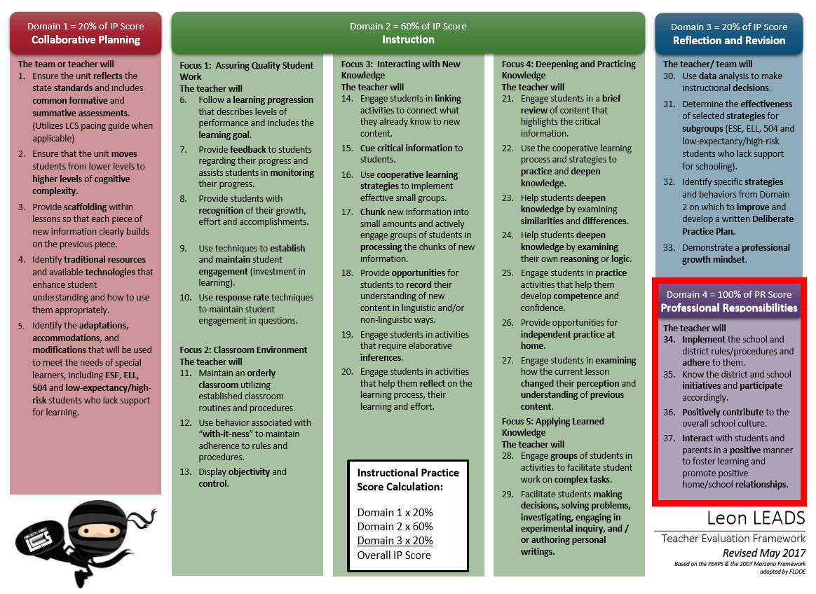
Instructional Practice Score
PR
Score

Slide 4
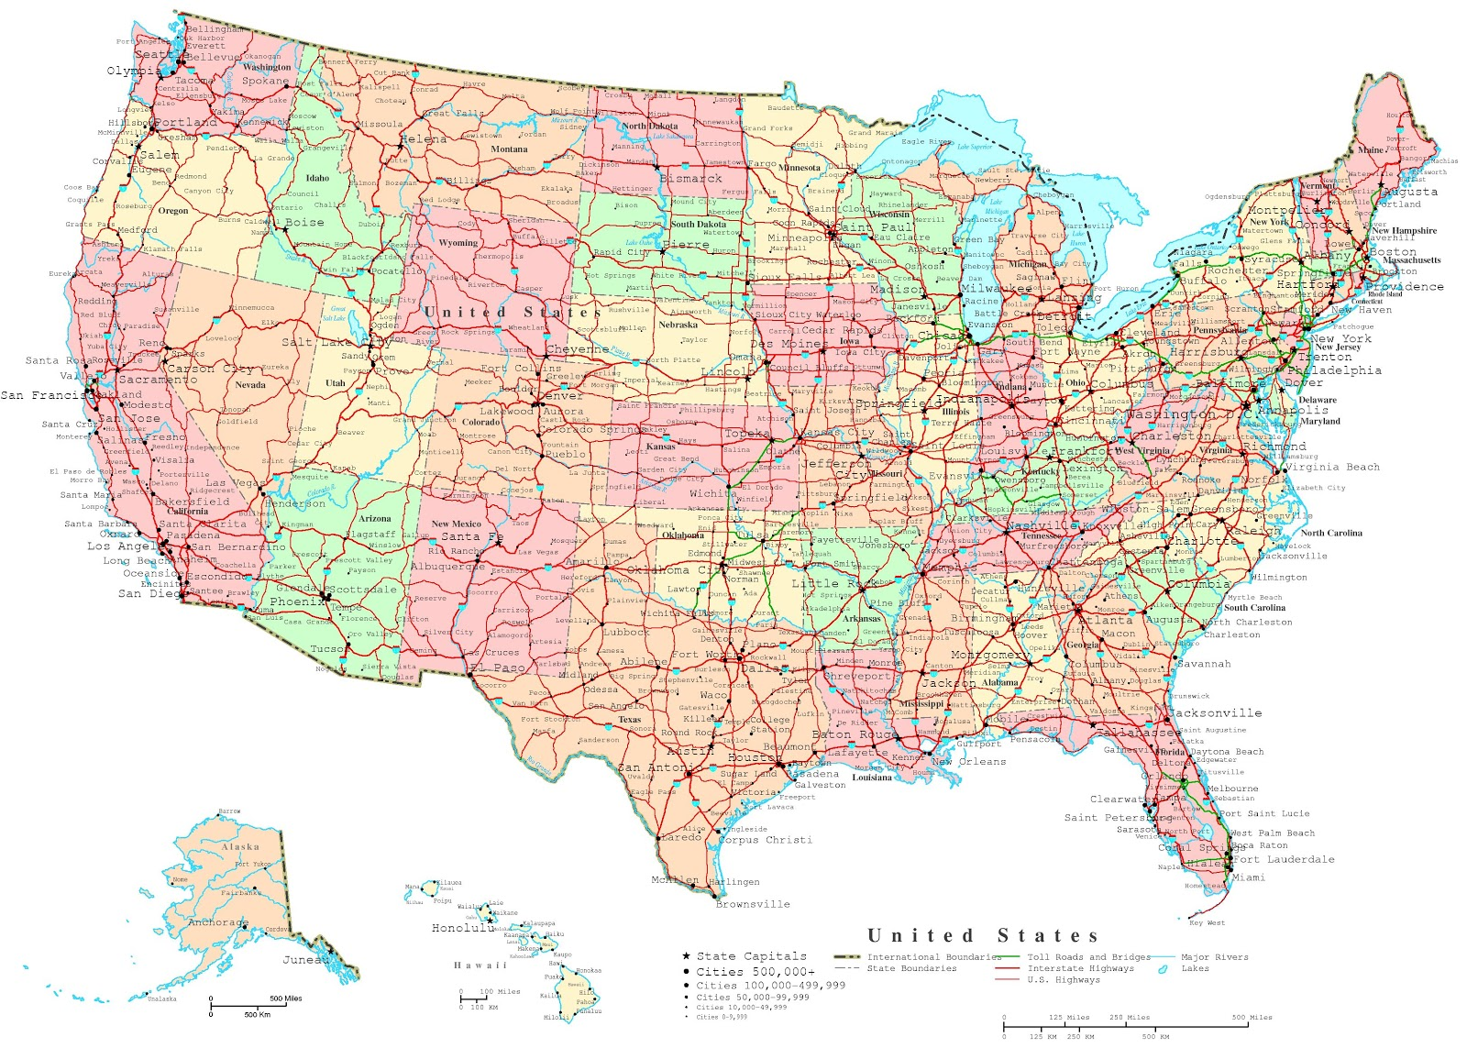
leon Leads map

Slide 5
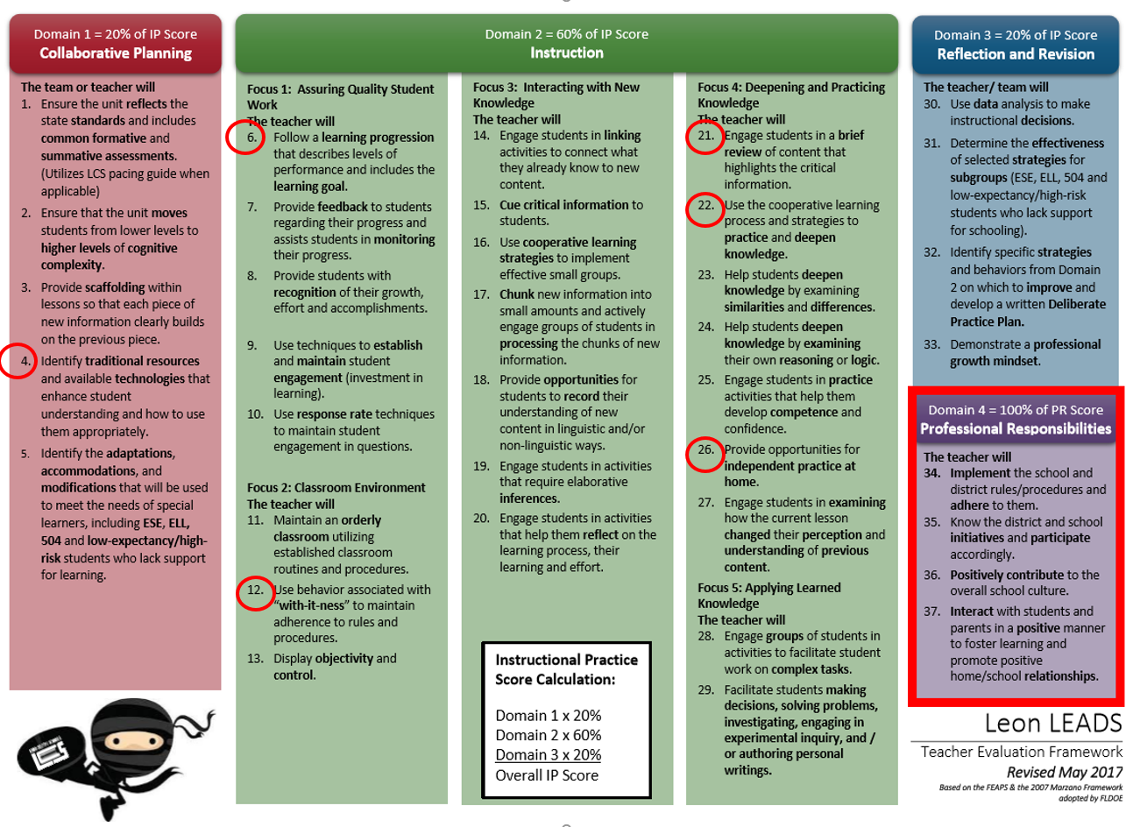

Slide 6
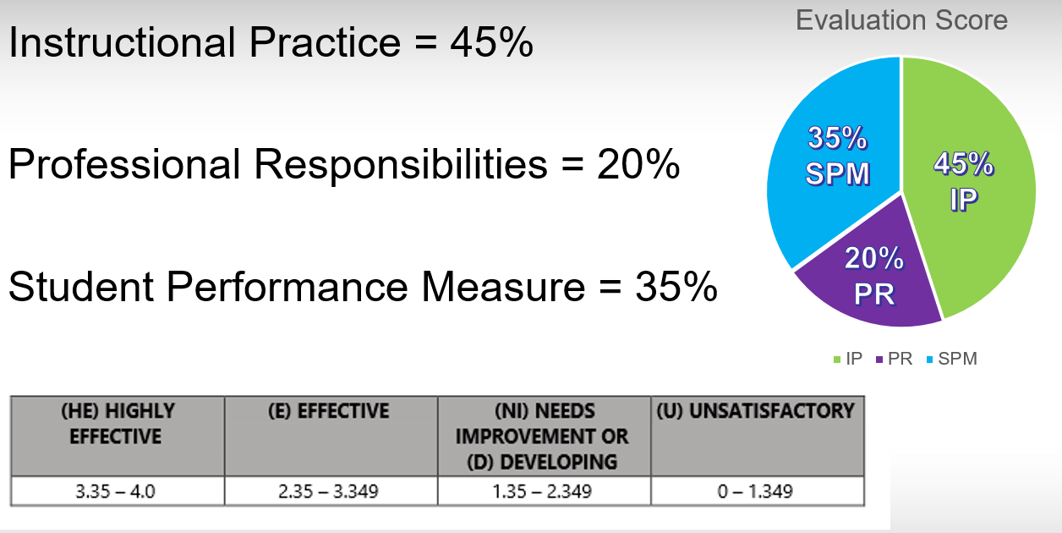
Evaluation Calculation

Slide 7
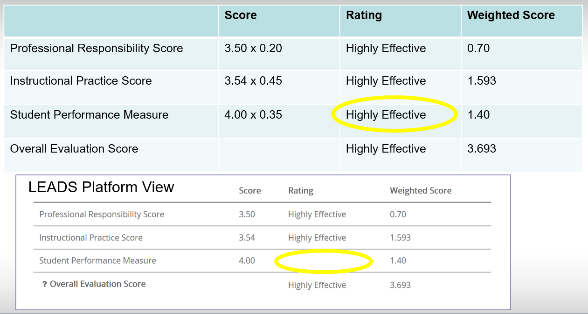
Evaluation Calculation

Slide 8
Using the rating scale

Slide 9
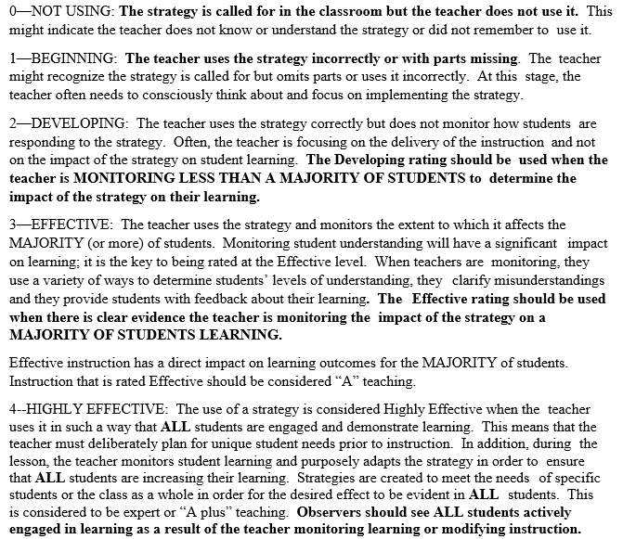
Using the rating scale

Slide 10
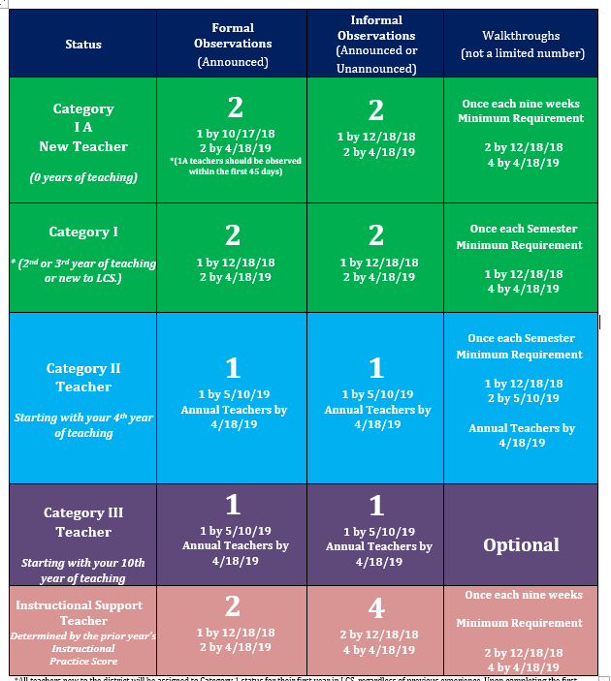
Schedule of Observations
Important Dates:
10-17-2018
12-18-2018
4-18-2019
5-10-2019

Slide 11
Types of Instructional Practice Observations
Formal Observations- Scheduled, Pre Conference, Observation (Approx. 50 minutes), Post Conference.
(See Schedule of Observations for Required Number)
Informal Observations- Not scheduled, Minimum of 5 minutes.
(See Schedule of Observations for Required Number)
Walkthroughs- Not scheduled and No limit as to number of walkthroughs per year.
Non-Evaluative Walkthroughs- Not scheduled, and No limit as to number of walkthroughs per year, Does not count towards evaluation scores.

Slide 12
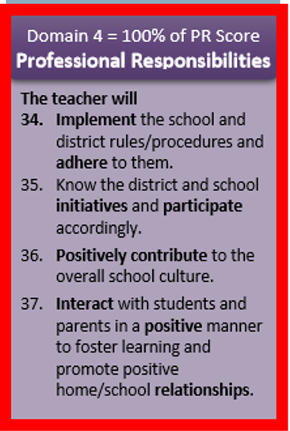
Types of Professional Responsibility Evaluations
Domain 4-Evaluative- Elements 34-37, 20% of Overall Evaluation Score, No limit to the number of Domain 4 observations.
Domain 4- Non-Evaluative- Does not count towards evaluation scores, No limit to the number of Domain 4 observations.

Slide 13
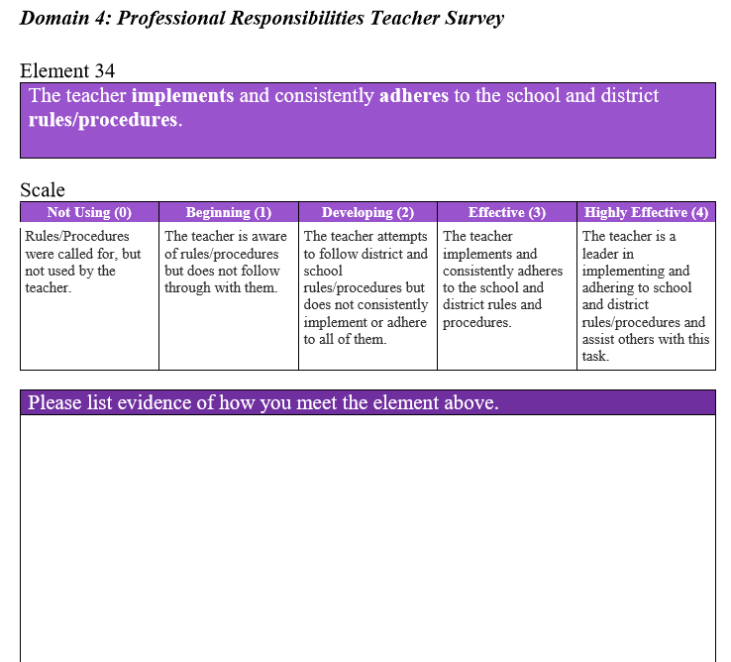
Professional Responsibilities Teacher Survey
Domain 4- Survey (Optional)-
Located under the “Resources” tab in Leon LEADS.
For Elements 34, 35, 36, 37: document experience and examples of performance.

Slide 14
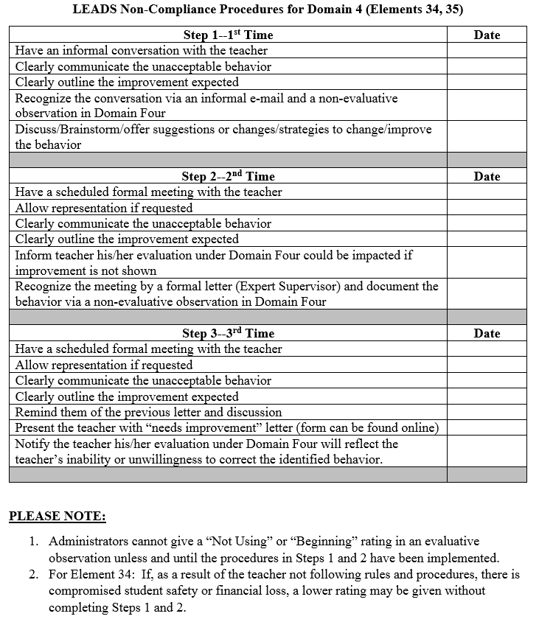
Non-Compliance Procedures for Domain 4 (Elements 34, 35)-
Three step procedures for non-compliance.
Documented in Domain 4 as Non-Evaluative for first and second times. Documented as Evaluative for the third time.
*The exception to this is when it involves student safety or financial loss, an evaluative rating may be given without first and second step.*

Slide 15
Student Learning Objectives
Table Talk:
Review the SLOs submitted by Leona L. Leads with your table.
If you were Leona L. Leads teacher leader, what are some suggestions that you would give her? (If any).
Evaluation Plan | Student Learning Objective | How will it be measured? | Other measurement method | Teacher Name | Primary Site
Leon LEADS Category 2 & 3 Evaluation 2017-2018 | SLO # 2 75% of Kindergarten and 1st grade matched and qualified students target group will have less than 5 absence in the 4th nine weeks. | Other Assessment Measure | School Generated Attendance Report from Genesis | Leona L. Leads | Ninja Warrior Elementary
Leon LEADS Category 2 & 3 Evaluation 2017-2018 | SLO # 3 100% of matched and qualified ESE students will have an IEP and a Matrix for services | Other Assessment Measure | School Generated Report from A3 | Leona L. Leads | Ninja Warrior Elementary

Slide 16
Student Learning Objectives Matched and Qualified
FTE
Matched- students are present in the teachers class / course for the October and February FTE counts and have not been withdrawn from school for any extended time between the two FTE counts.
Qualified- students qualify if they have not been absent from the teachers class / course.
10 or more days in one month (excused or unexcused
15 or more days in a semester (excused or unexcused)
These absences must be documented in teacher attendance through the SIS (formerly Genesis, now FOCUS).
Feb.
Oct.

Slide 17
Student Learning Objectives and Student Performance Measure Calculation

Slide 18
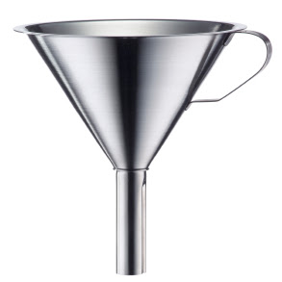
Deliberate Practice Plan
Purpose:
The purpose of the Deliberate Practice Plan is to grow our instructional practice through deliberate, purposeful practice.
The Deliberate Practice Funnel
-Complete Self-Assessment
-Review Past Observations
-What needs to be focused on?
All Elements
Highly
Effective
Elements
Effective
Elements
Developing
Elements
Unsatisfactory
Elements
Deliberate Practice
Plan Element

Slide 19
Deliberate Practice Plan
Process:
Complete Self- Assessment
Review Evaluation data from previous years, determine what element to work on for the year based on data and your current Self-Assessment
Create your Deliberate Practice Plan
Gain approval from your administrator
Work on your DPP element throughout the year – be sure to include it in your formal pre and post conference discussions with your administrator. What did you do and what did they see?
The reflection process can be revisited throughout the year and doesn’t happen at the end only. Learning is ongoing.
Complete your End of the Year summary. Review your evaluation data and reflect.

Slide 20
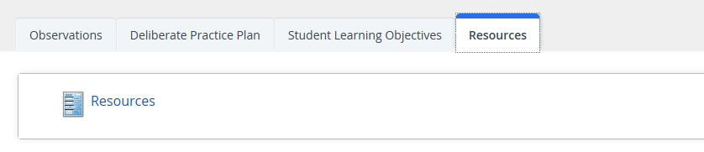
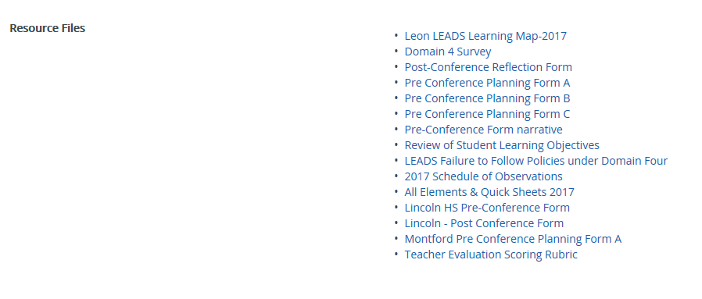
Review Resources

Slide 21
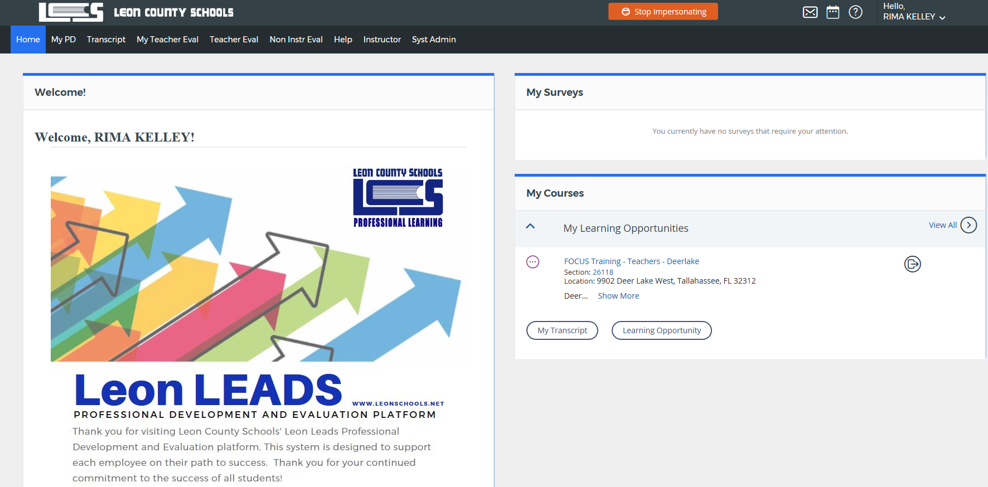
Leon LEADS Platform Review
Leon.truenorthlogic.com

